Slide 1


Redux - State management
In this lession, you will learn:
- Install Redux, ReactRedux, Redux Thunk
- Understanding of Redux Flow
- Detail tutorials about Store, Reducers, Actions,...
- HOC(Higher Order Component) with “connect”
- Small examples for clearing Redux concepts

Slide 2
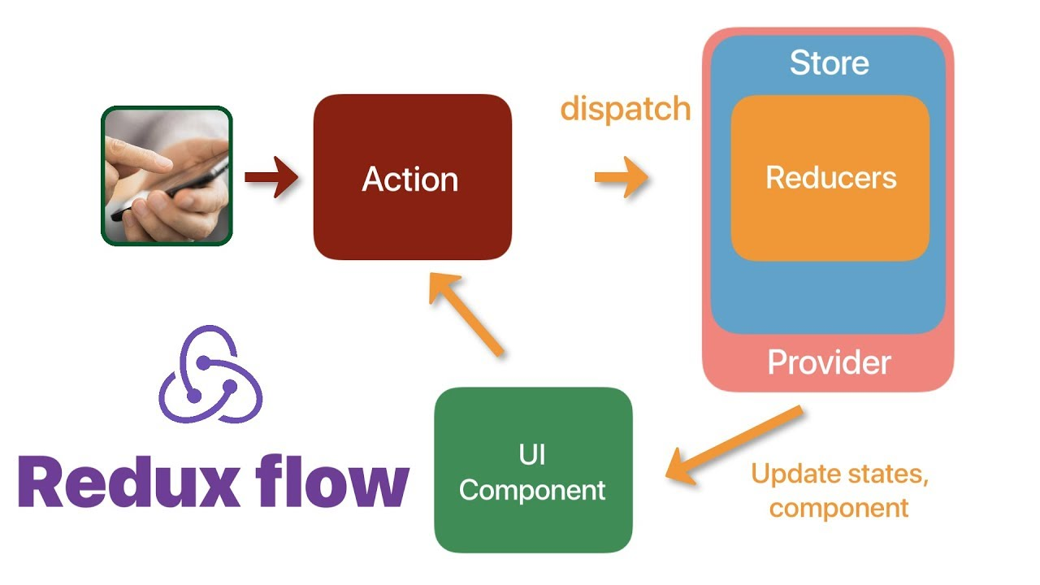
Redux Flow
Redux is a predictable state container for JavaScript apps. When 2 or more components have “shared states”, we use Redux

Slide 3
Install Redux
Redux is available as a package on NPM for use with a module bundler
> npm install redux react-redux redux-thunk #node package manager
> yarn add redux
> npx create-react-app myReactProject --template redux #new project only
Some examples of Redux maybe:
- Counter App, Todo App
- Shopping Cart, Redux for Realtime Gaming, ...

Slide 4
Actions
Actions are payloads of information that send data from your App to your store. When user interact your Web => event & action are created
//1 action = 1 function which returns {type: “a string”, payload: “an object”}
const addToCartUnsafe = productId => ({
type: ADD_TO_CART,
productId //maybe a JavaScript Object
})
Action can be a function which returns a function:
export const addToCart = productId => (dispatch, getState) => {
const {products} = getState() //”shared state” is {cart, products}
if (checkProductIdInInventory()) {
dispatch(addToCartUnsafe(productId)) #actionA ”dispatch” actionB
}
}

Slide 5
Actions
An action can dispatch many other actions:
export const checkout = productsInCart => (dispatch, getState) => {
const { cart } = getState()
dispatch({
type: CHECKOUT_REQUEST //this action have “no payload”
})
buyAllProductsInCart(productsInCart, () => {
dispatch({
type: CHECKOUT_SUCCESS,//maybe CHECKOUT_FAILED,
cart
})
})
}

Slide 6
Reducers
Reducers specify how the application's state changes in response to actions sent to the store.
//an Example of ”shared state” is:
{
cart: {
addedIds: [1,5,3],
quantityById: {2, 1, 1}
},
products: []
}
//=> we have 2 reducers cardReducer, productsReducer

Slide 7
Reducers
Each reducer is a JS file which contains function which change
oldState => newState. This is cardReducer.js
const initialState = {
addedIds: [], //You must define for preventing "null" object
quantityById: {}
}
const cartReducer = (state = initialState, action) => {
switch (action.type) {
case CHECKOUT_REQUEST:
return newStateCloneAndChangeFromInitialState
//other actions...
default: return initialState
}
}
export default cartReducer

Slide 8
Reducers
Each reducer is a JS file which contains function which change
oldState => newState. This is productsReducer.js
const initialState = {
//You must define for preventing "null" object
}
const productsReducer = (state = initialState, action) => {
switch (action.type) {
case AN_ACTION_TYPE:
return newStateCloneAndChangeFromInitialState
//other actions...
default: return initialState
}
}
export default productsReducer

Slide 9
Combine Reducers
combineReducers() combines some Reducers to a single object. The state parameter is different for every reducer, and corresponds to the part of the state it manages
//In reducers/index.js
import { combineReducers } from 'redux'
//import cartReducer, productsReducer
export default combineReducers({
cartReducer, //let change cartReducer => cart and see the diferrent ?
productsReducer
})
//Actions => reducers => store ?

Slide 10
Store
The Store is the object that brings (Actions + Reducers) together
It is also known as a “global object”
import thunk from 'redux-thunk'//we use redux-thunk as middleware
import reducer from './reducers' //path to reducers folder
const middleware = [ thunk ];
const store = createStore(
reducer,
applyMiddleware(...middleware)
)
export default store //save these code lines to store.js

Slide 11
Usage with React
We will also need some containers to connect the presentational components to Redux.
class ComponentName extends Component {
const mapStateToProps = (state) => ({
propsA: calculateFromState(state),
//other propB, propC, ...let debug for more detail
}
)
const mapDispatchToProps = dispatch => {
return {
aFunctionName: () => dispatch({ type: 'ACTION_TYPE_NAME' }),
}
}
//in render: ...onClick={this.props.aFunctionName()}
}
export default connect( //convert Component to container
mapStateToProps,
mapDispatchToProps
)(ComponentName)

Slide 12
Usage with React
We will also need some containers to connect the presentational components to Redux.
class ComponentName extends Component {
const mapStateToProps = (state) => ({
propsA: calculateFromState(state),
//other propB, propC, ...let debug for more detail
}
)
const mapDispatchToProps = dispatch => {
return {
aFunctionName: () => dispatch({ type: 'ACTION_TYPE_NAME' }),
}
}
//in render: ...onClick={this.props.aFunctionName()}
}
export default connect( //convert Component to container
mapStateToProps,
mapDispatchToProps
)(ComponentName)

Slide 13


